Slide 1
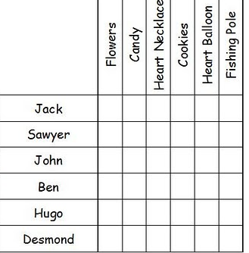
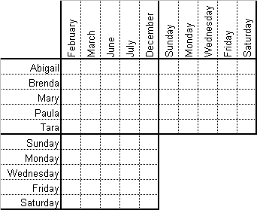
Logic

Slide 2
There are four girls in the Perry family. Ellis is older than Melissa and younger than Heidi. Susan is not the oldest or the youngest. Ellis does not have two older sisters. Write the names of the girls from youngest to oldest.
Answer: Melissa Susan Ellis Heidi

Slide 3
There are four boys in the Douglas family. Donny is older than Danny and younger than Devon. Drew is not the oldest or the youngest. Donny does not have two younger brothers. Write the names of the boys from oldest to youngest.
Answer: Devon Drew Donny Danny

Slide 4
Points E, F, G, and H are on a line, but not in that order. Point F is to the left of point E. Point H is between Point F and G. Point G has no point to the right of it. Point H is to the left of Point E. List the points in order.
Answer: FHEG

Slide 5
Points A,B,C, and D are on a line, but not in that order. Point B is to the left of point D. Point A is between Point C and D. Point C has no point to the left of it. Point A is to the left of Point B. List the points in order.
Answer: CABD

Slide 6
Linus, Cameron, Kyle, and Ferdinand have different pets: a parakeet, a goldfish, a hamster, and a cat. Ferdinand’s pet does not have hair. Linus’s pet can swim. Kyle’s pet would love to eat Cameron’s pet. Ferdinand loves to feed seeds to Linus’ pet. Who has a hamster?
 | Parakeet | Goldfish | Hamster | Cat
Linus | O | X | X | X
Cameron | X | X | O | X
Kyle | X | X | X | O
Ferdinand | X | O | X | X
Answer: Cameron

Slide 7
Four people have choir tryouts at 9:00, 10:00, 11:00. and 12:00. Georgia’s tryout is before Tina and Penelope. Penelope’s tryout is after Tina. Donna’s tryout is before Georgia. Who tries out at 11:00?
 | 9:00 | 10:00 | 11:00 | 12:00
Georgia | X | O | X | X
Tina | X | X | O | X
Penelope | X | X | X | O
Donna | O | X | X | X
Answer: Tina
Notes:
?

Slide 8
Jack, Jimmy, John, and Justin got different grades on the Math test. Jack scored better than John. Jimmy scores lower than Justin but higher than John. Justin scored 5 points higher than Jack. Who did the worst on the test?
 | 95 | 90 | 87 | 82
Jack | X | O | X | X
Jimmy | X | X | O | X
John | X | X | X | O
Justin | O | X | X | X
Answer: John

Slide 9
Four girls go to cheerleading camp in June. Kim goes before Kathy. Kelly goes before Kris, but after Kim. Kathy does not go last. Kelly will leave on the day Kathy returns. In what order did the girls go to camp?
 | 1st | 2nd | 3rd | 4th
Kim | O | X | X | X
Kathy | X | O | X | X
Kelly | X | X | O | X
Kris | X | X | X | O
Answer: Kim, Kathy, Kelly, Kris
Notes:
?

Slide 10
Sybil, Shelly, Shauna, and Stephanie all want something different for their birthday: a watch, a snow cone machine, a necklace, and a belt. Sybil does not want something you wear. Shelly hates to wear anything around her neck or wrist. Stephanie hates to replace batteries in anything. What did each girl want for their birthday?
 | watch | snow cones | necklace | belt
Sybil | X | O | X | X
Shelly | X | X | X | O
Shauna | O | X | X | X
Stephanie | X | X | O | X
Answer: Sybil-snow cone machine, Shelly-belt, Shauna-watch, Stephanie-necklace

Slide 11
Jenna, Hallie, Derek, and Wade were planning on being a nurse, a chef, a teacher, and a scientist. Jenna likes experimenting with new recipes. Hallie likes helping her neighbor with his homework and Derek faints at the sight of blood. Which career do you think each person will choose?
 | nurse | chef | teacher | scientist
Jenna | X | O | X | X
Hallie | X | X | O | X
Derek | X | X | X | O
Wade | O | X | X | X
Answer: Jenna-chef, Hallie-teacher, Derek-scientist, Wade-nurse

